Slide 1

DDoS Detection using Trust-Aware Federated Learning for Heterogeneous Collaborators
National Technical University of Athens
School of Electrical and Computer Engineering
Division of Communication, Electronic and Information Engineering
Network Management and Optimal Design Laboratory
Presentation of Diploma Thesis
Vasilis Petrakopoulos
Supervisor: Symeon Papavassiliou
Co-Supervisor: Vasilis Maglaris
Athens, July 2022

Slide 2
Outline
Collaborative Attack Detection
Federated Learning (FL)
Related Work
Contribution: Trust-Aware Heterogeneous FL
Methodology for Heterogeneous FL
Trust-Aware FL
Trust & Heterogeneity
Dataset Description
Experimental Evaluation
Experiments
Results
Conclusions
Future Work

Slide 3
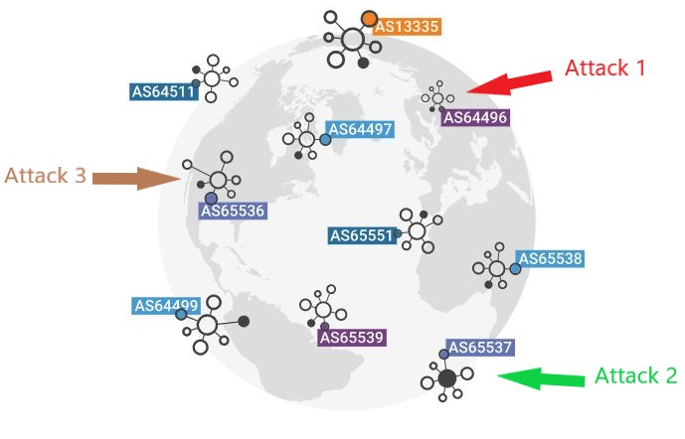

Collaborative Attack Detection
DDoS attacks major problem
Need of rapid & accurate detection mechanisms
Detection via machine learning
Gathering of data from different AS’s?
Data privacy
... Federated Learning!
https://www.cloudflare.com/learning/network-layer/what-is-an-autonomous-system/

Slide 4
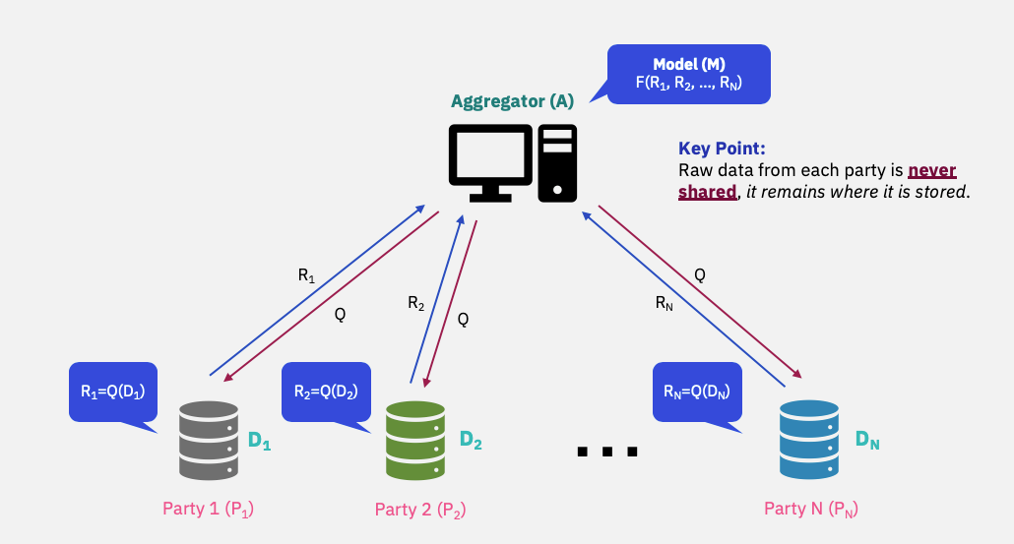
Federated Learning
Limited number of trusted and computationally powerful collaborators
Problem statement:
Multi-domain collaborators need to agree on common model architectures
What if a collaborator’s model parameters diverge from others during training?
https://towardsdatascience.com/introduction-to-ibm-federated-learning-a-collaborative-approach-to-train-ml-models-on-private-data-2b4221c3839

Slide 5
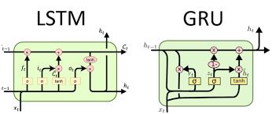
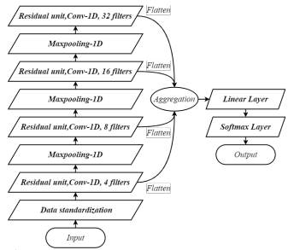

Related Work
Related efforts using FL: design neural networks for the highest possible accuracy
Our double approach with simple MLP models:
https://www.tutorialexample.com/lstm-vs-gru-network-which-has-better-performance-deep-learning-tutorial/
federated training of heterogeneous clients
trust-based scheme for unreliable clients
Tian, Guang, Wenchao, Si, “A Lightweight Residual Networks Framework for DDoS Attack Classification Based on Federated Learning, 2021

Slide 6
Contribution: Trust-Aware Heterogeneous FL
Heterogeneous Federated Learning:
Communication of clients towards a common model:
inefficient
human intervention
Solution: clients contribute to a federated model with features selected according to their own criteria
Trust-aware Federated Learning:
Some clients may not behave properly:
unintentionally, e.g. faulty data
final model negatively affected
Solution: client’s model diverges ⇒ diminish influence in aggregation

Slide 7
Methodology for Heterogeneous FL [1]
Input
Hidden
Output
wh1,1
wh1,6
wo1,1
wh1,2
Input
Hidden
Output
Feature 1
wh1,7
wo1,2
wh1,3
wh2,1
wo1,3
wh2,5
wo2,1
wh1,8
wh1,4
wo1,4
Feature 1
wh2,2
Feature 2
wo2,2
wh1,9
wh2,6
wh1,5
wo1,5
wh2,3
wo2,3
Feature 3
wh2,7
wh1,10
wh2,4
wh1,3: 3rd weight of hidden layer of model 1
wo2,3: 3rd weight of output layer of model 2
wo2,4
wh2,8
[1]: E. Diao, J. Ding and V. Tarokh. HeteroFL: Computation and Communication Efficient Federated Learning for
Heterogeneous Clients. In Proceedings of the International Conference on Learning Representations (ICLR), 2021.
https://arxiv.org/abs/2010.01264

Slide 8

(wh1,1+wh2,1)/2
wh1,6
Feature 1
wh2,5
(wo1,1+wo2,1)/2
(wh1,2+wh2,2)/2
wh1,7
(wo1,2+wo2,2)/2
wh2,6
(wh1,3+wh2,3)/2
Feature 2
wh1,8
(wo1,3+wo2,3)/2
wh2,7
(wh1,4+wh2,4)/2
(wo1,4+wo2,4)/2
wh1,9
wh2,8
Feature 3
wo1,5
wh1,10
wh1,5
0
Key idea:
clients contribute only to their relevant weights
federated model learns what each client can teach

Slide 9
Trust-Aware FL [2]
What we want: diminish influence of markedly diverging models
What we need: trust values to multiply weights in aggregation
Divergent models get smaller trust values
How to calculate trust values: directly compare weights of clients’ models
[2]: A. Gholami, N. Torkzaban and J. S. Baras. On the Importance of Trust in Next-Generation
Networked CPS Systems: An AI Perspective. arXiv, 2021. https://arxiv.org/abs/2104.07853

Slide 10
Trust-Aware FL
For each client a sum is calculated
For each client i:
sum[i] = 0
For each client j:
sum[i] += norm(model_weights(j) – model_weights(i))^2
Greater sums indicate markedly diverging models of clients

Slide 11
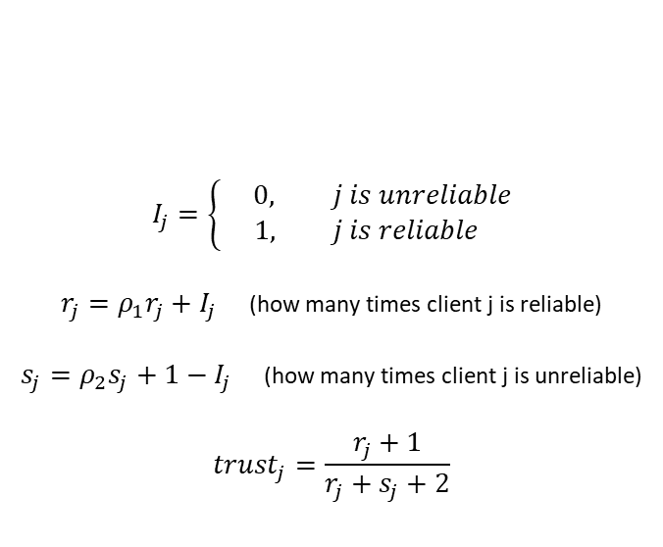
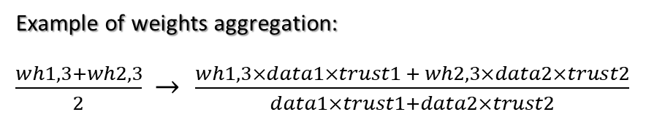
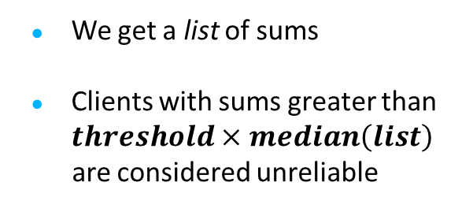
Trust-Aware FL
We get a list of sums
Clients with sums greater than $threshold×median\left(list\right)$
are considered unreliable
$$I_{j}=\left\{\begin{aligned} 0, j is unreliable \\ 1, j is reliable\end{aligned}\right.$$
$r_{j}=ρ_{1}r_{j}+I_{j}$ (how many times client j is reliable)
$s_{j}=ρ_{2}s_{j}+1−I_{j}$ (how many times client j is unreliable)
$${trust}_{j}=\frac{r_{j}+1}{r_{j}+s_{j}+2}$$
Example of weights aggregation:
$\frac{wh1,3+wh2,3}{2}$ → $\frac{wh1,3×data1×trust1 + wh2,3×data2×trust2}{data1×trust1+data2×trust2}$

Slide 12

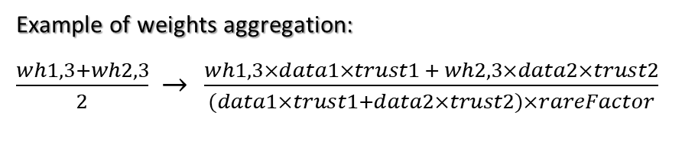
Trust & Heterogeneity
Heterogeneity: trust sums calculations consider only relevant weights of clients
Problem: abnormal values of weights for features selected by few clients
Solution: diminish influence of these weights
How: divide these weights in aggregation
Key idea: least common features probably not important for classification
Example of weights aggregation:
$\frac{wh1,3+wh2,3}{2}$ → $\frac{wh1,3×data1×trust1 + wh2,3×data2×trust2}{(data1×trust1+data2×trust2)×rareFactor}$

Slide 13
Dataset Description
Datasets:
Benign traffic – WIDE Backbone [3]
Attack traffic – Booters (DDoS-for-hire services) – 7 different DNS attacks [4]
Each collaborator corresponds to an AS with access to:
benign network data (aggregated by destination AS) from [3]
a single attack from [4]
Experiments with 7, 14, 21 collaborators
[3]: MAWI Working Group Traffic Archive. http://mawi.wide.ad.jp/mawi/. Access date: 2022-05-24.
[4]: J. J. Santanna, R. van Rijswijk-Deij, R. Hofstede, A. Sperotto, M. Wierbosch, L. Z. Granville and A. Pras. Booters — An analysis
of DDoS-as-a-service attacks. In Proceedings of the International Symposium on Integrated Network Management, 2015.
https://ieeexplore.ieee.org/document/7140298

Slide 14
Experimental Evaluation
Heterogeneous models generation:
Feature selection procedure (random forest) on clients’ private datasets
Individual models with heterogeneous features and number of features
What about trust?
Booter 5 unsuccessful attack (low bandwidth)
Models of clients encountered 5th attack diverge
Using trust to diminish their influence benefits model

Slide 15
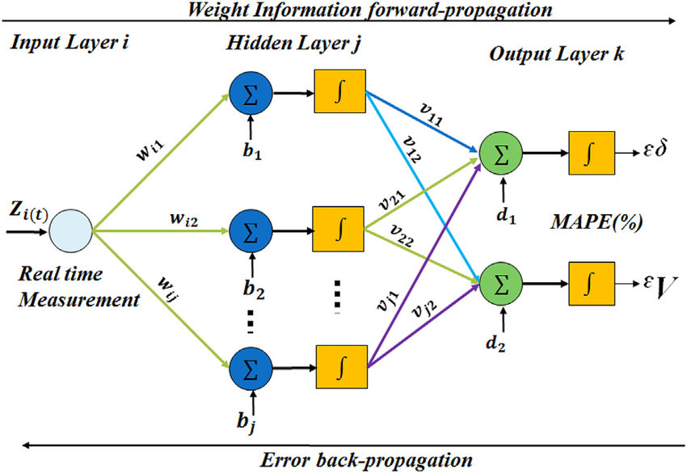
Experimental Evaluation
2-layer MLP neural networks:
n inputs (n number of chosen features)
2n+1 neurons hidden layer [5] (with ReLu activation function)
1 output (with Sigmoid activation function)
https://www.researchgate.net/figure/Multilayer-perceptron-neural-network-model_fig1_314176848
[5]: C. Siaterlis and B. Maglaris. Detecting DDoS attacks using a multilayer Perceptron classifier.
In Proceedings of the 9th IFIP/IEEE International Symposium on Integrated Network Management, 2004.

Slide 16
Experiments
3 experiments:
Individual models vs FL model
Trust-aware FL vs FL without trust
Feature selection in FL

Slide 17
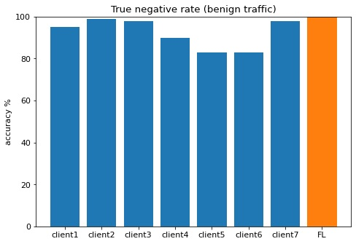
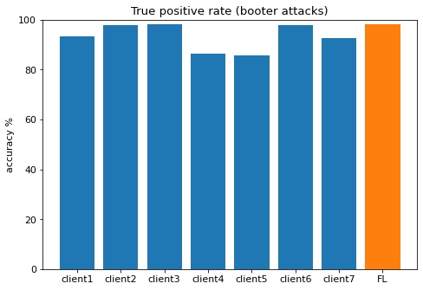
Individual Models vs FL Model
Performance of clients on their own vs FL model (7 clients)

Slide 18
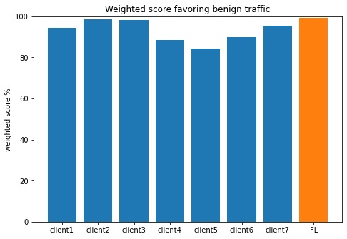
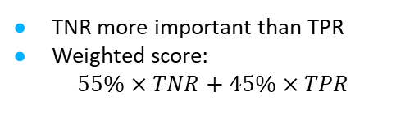
Individual Models vs FL Model
Performance of clients on their own vs FL model (7 clients)
TNR more important than TPR
Weighted score:
$55\%×TNR+45\%×TPR$
Minimum gain: 0.7% (client 2)
Maximum gain: 15% (client 5)

Slide 19
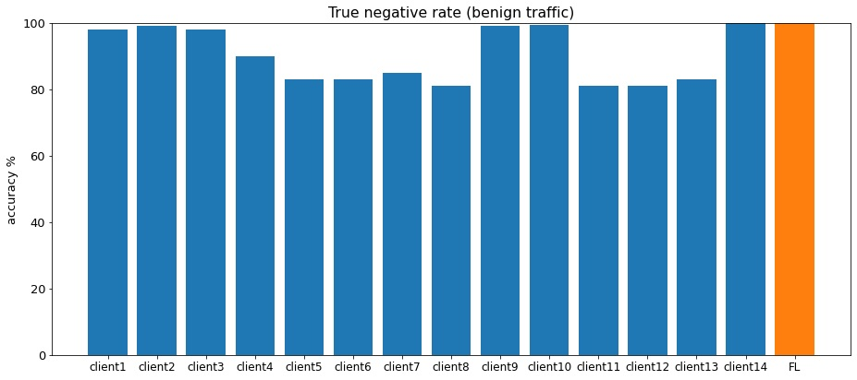
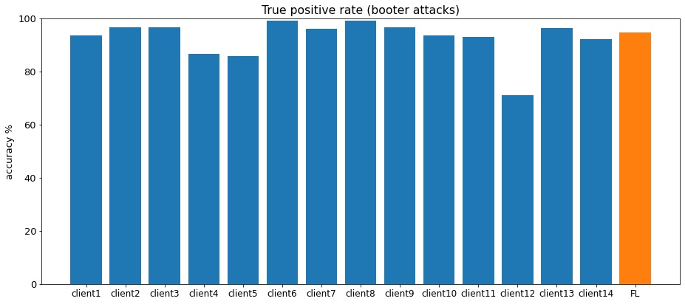
Individual Models vs FL Model
Performance of clients on their
own vs FL model (14 clients)
Minimum gain (loss): -0.23% (clients 2 and 9)
Maximum gain: 21.4% (client 12)

Slide 20
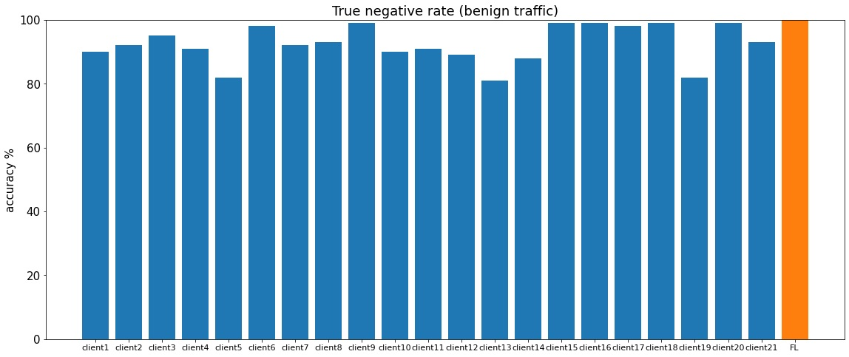
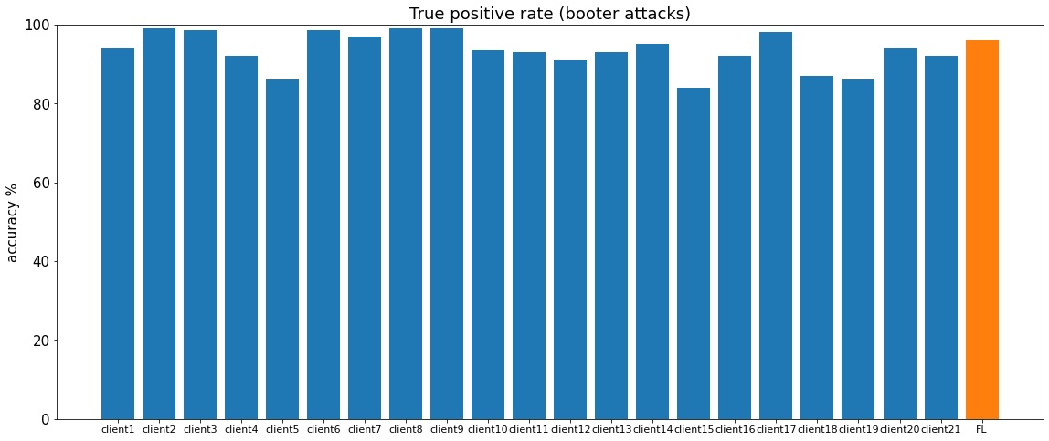
Individual Models vs FL Model
Performance of clients on their
own vs FL model (21 clients)
Minimum gain (loss): -0.82% (client 9)
Maximum gain: 14.4% (client 12)

Slide 21

Individual Models vs FL Model
Performance of clients on their own vs FL model
Average gain: 5.5% (21 clients)
More than 90% of clients gain in accuracy (21 clients)
Effective method – clients learn to distinguish new attacks
Motivation to join
Scalability

Slide 22
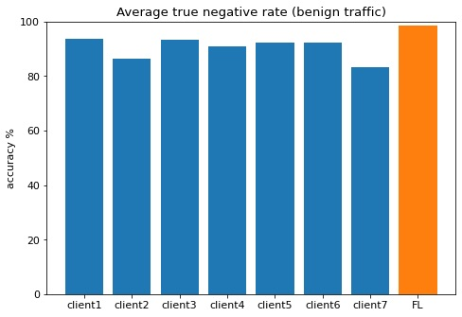
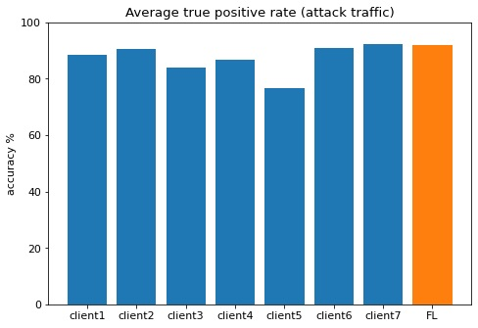
Individual Models vs FL Model
Average of 20 runs with random distribution of attacks
Minimum gain: 3.8% (client 6)
Maximum gain: 10.2% (client 5)

Slide 23
Individual Models vs FL Model
Average of 20 runs with random distribution of attacks
Average gain: 6.65%
All clients gain in accuracy
Beneficial method in real case scenario
Greater motivation to join

Slide 24
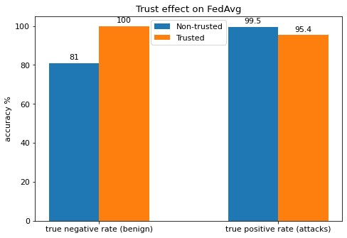
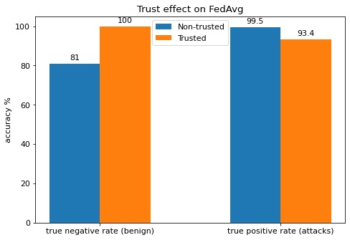
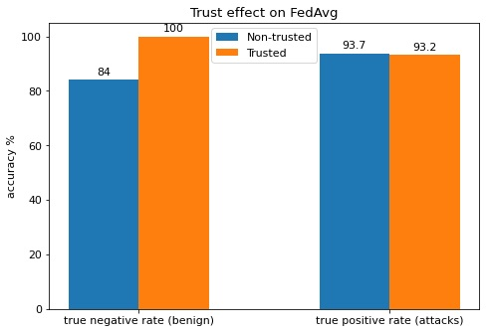
Trust-Aware FL vs FL without Trust
Trust effect (7, 14 and 21 clients)
Trust factor gain: 8.5%
Trust factor gain: 7.6%
Trust factor gain: 8.5%
Trust factor beneficial for FL

Slide 25
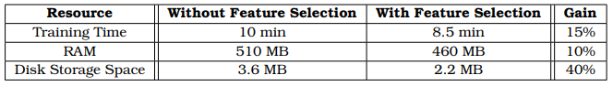
Feature Selection in FL
Feature selection benefit
Client with 16 features reduced to 8 after feature selection
Local training
Feature selection possible due to heterogeneous FL
Lower energy cost

Slide 26
Conclusions
Trust-aware Heterogeneous FL for collaborative DDoS detection
Individual models vs FL model
FL model outperforms more than 90% of individual models
Motivation for collaboration
Trust factor for unreliable clients
Feature selection combined with FL – energy saving

Slide 27
Future Work
Different trust approach – malicious clients
Decentralized FL
Multi-task learning

Slide 28

Thank you!
Vasilis Petrakopoulos
el16105@mail.ntua.gr

